Slide 1
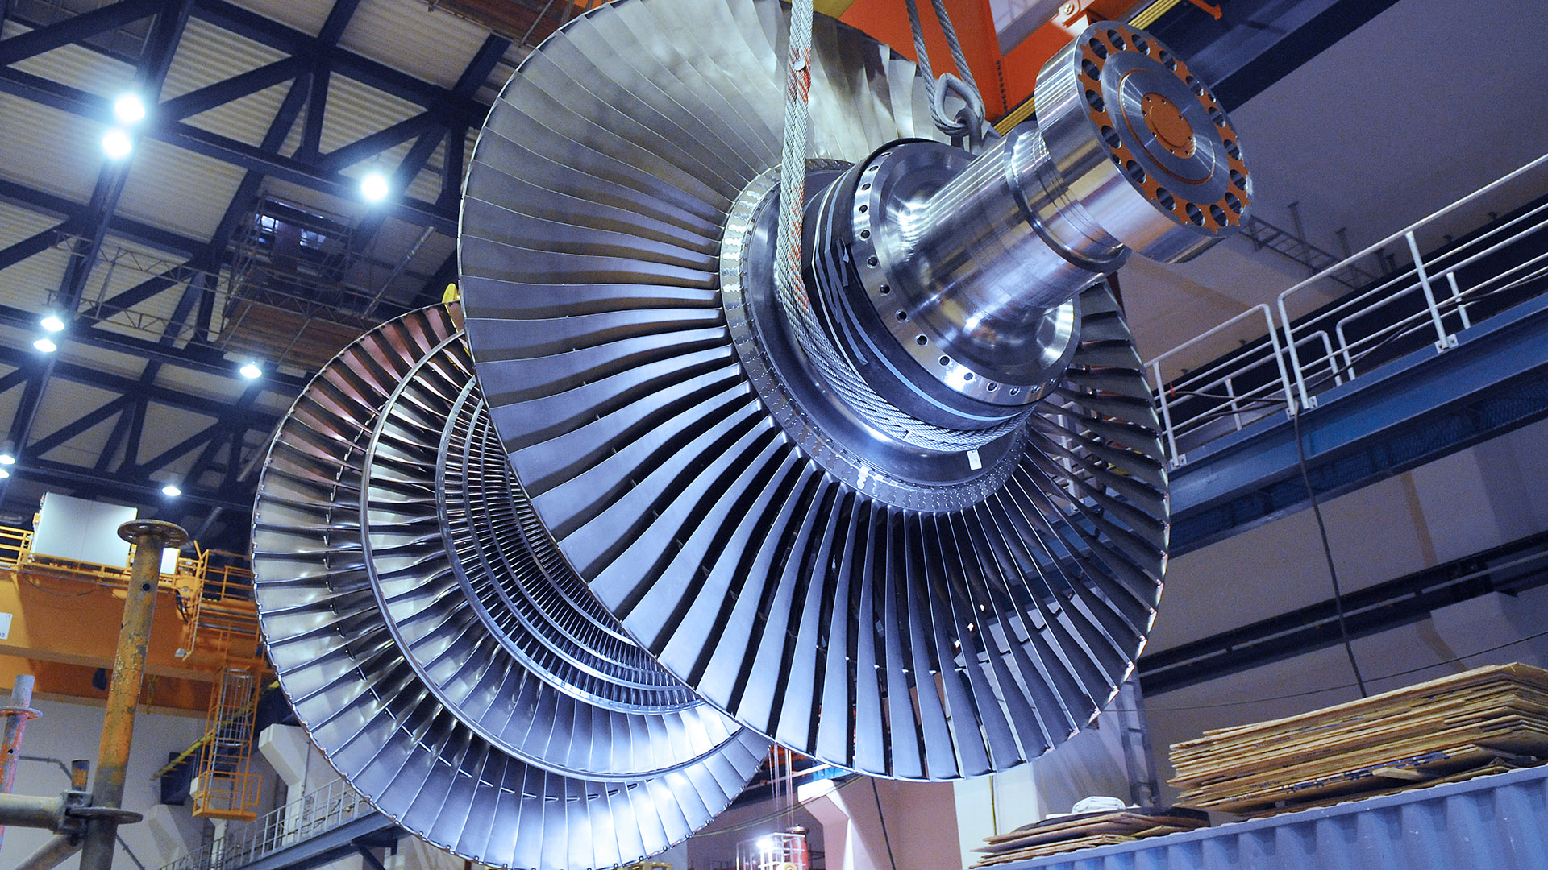
Working of Turbines in a Thermal Power Plant
Presentation in Basic Mechanical Engineering
109050. Atharva Tanavade, 109051. Balraj Tavanandi and 109054. Krishnaraj Thadesar
Division 9, Batch I3

Slide 2
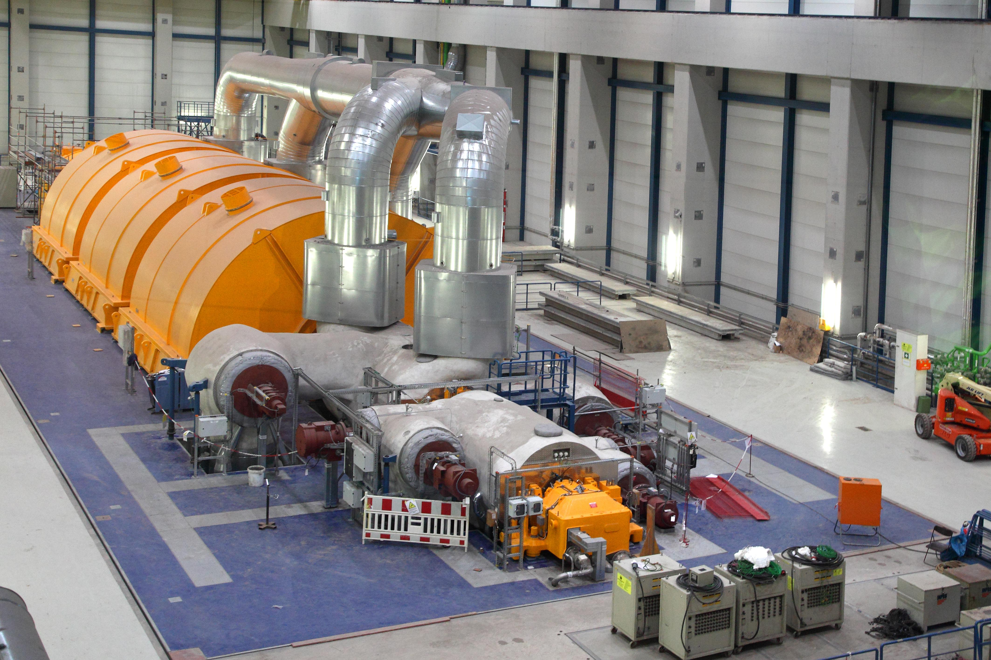
Types of Turbines
Steam turbines have been used predominantly as prime mover in all thermal power stations.
The steam turbines are mainly divided into two groups: -
1. Impulse Turbine
2. Impulse-Reaction Turbine

Slide 3
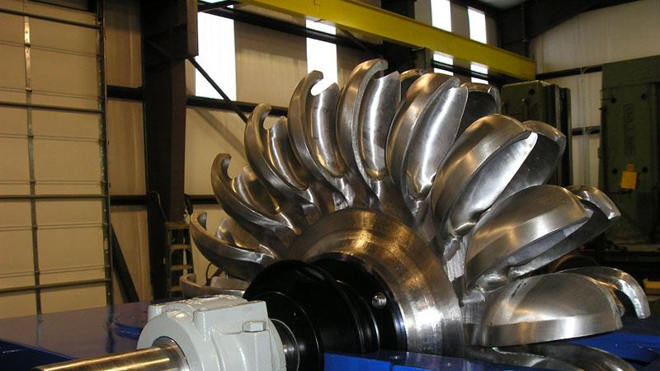
Impulse Turbine

Slide 4
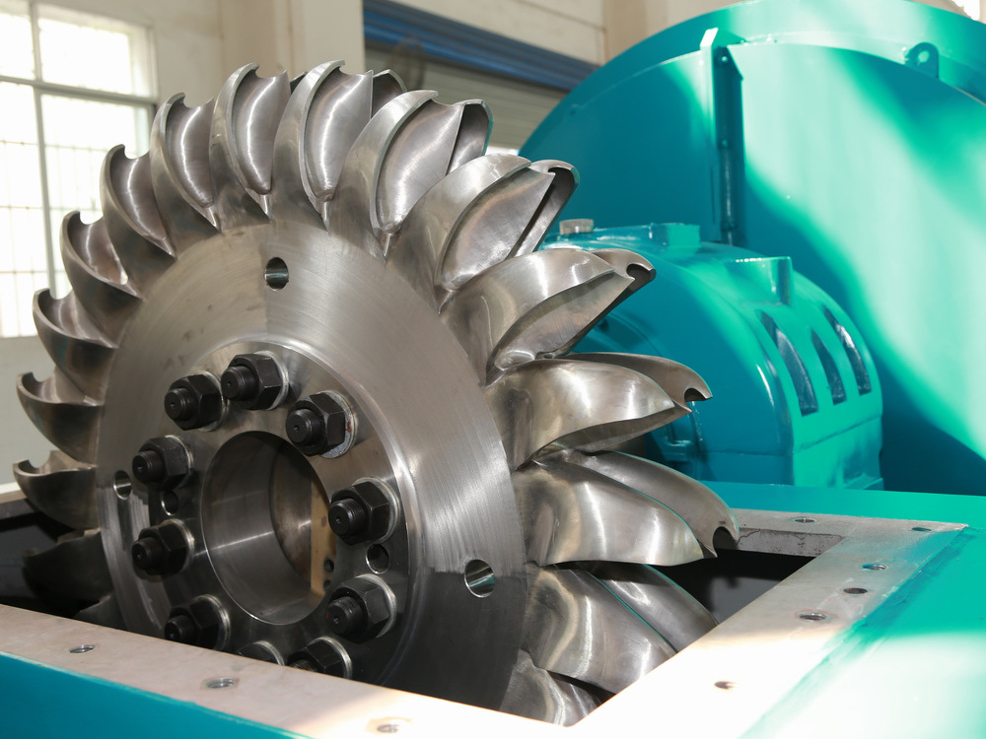

Slide 5
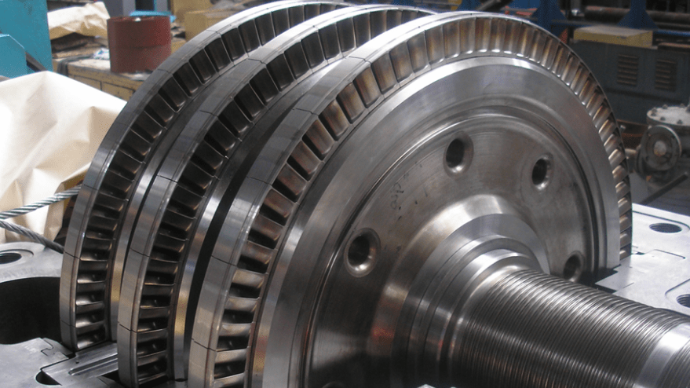
What is an Impulse Turbine
Impulse turbines are defined as turbines in which high-velocity jets of water or steam collide with the blades of the turbine to rotates the turbine and produce electricity using this winding. The impulse turbine is so named because it acts on the impulse force created for the striking blade of the water jet.
In impulse turbines, water hits the blade tangentially; hence it is also known as a tangent flow turbine. Impulse turbines are suited for high head and low discharge of water. This means that it is used when the amount of water flow is small, and there is high pressure due to the high location of the water head.

Slide 6

Description and working of impulse turbine
Impulse turbine is the one in which the available hydraulic energy is first converted into kinetic energy by means of efficient nozzle.
High velocity jet issuing from the nozzle then strikes a series of buckets fixed around the rim of wheel (runner).
The buckets change the direction of jet without changing its pressure.
The resulting change in momentum sets bucket and wheel into rotary motion and thus mechanical energy is made available at the turbine shaft

Slide 7
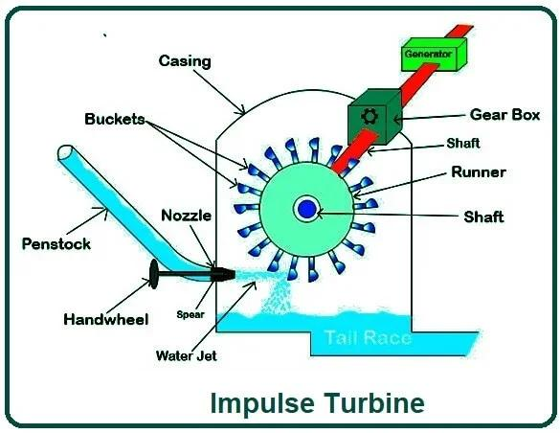
Parts of a impulse turbine
Penstock- It is a large size conduit which conveys water from high level reservoir to the turbine. The penstock may be of wood, concrete, or steel.
Spear and Nozzle -Nozzle is used to convert hydraulic energy into kinetic energy Spear is so arranged that it can move forward or backward there by decreasing or increasing the annular area of nozzle passage.

Slide 8
3. Casing – It is provided to prevent strong splash of water, which scatter in all directions and to guide the water to the tail race. This casing also acts as a safeguard against accidents.
4. Runner with bucket - The turbine rotor, called the runner is a circular disk carrying a number of cup shaped buckets which are arranged equidistantly around the periphery of the disk. For low heads the buckets are made of cast iron, but for higher heads they are made of bronze ,cast steel, or stainless steel.
5. Breaking jet-when the nozzle is completely closed, the amount of water striking the runner reduces to zero. But the runner due to inertia goes on revolving for long time. To stop the runner in short time, a small nozzle is provided which directs the jet of water on the back of vanes. This jet of water is called breaking jet.

Slide 9
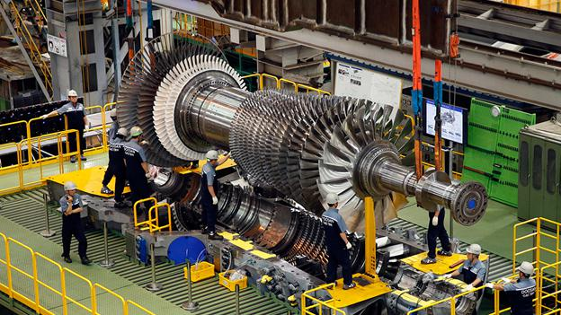
Reaction Turbines

Slide 10
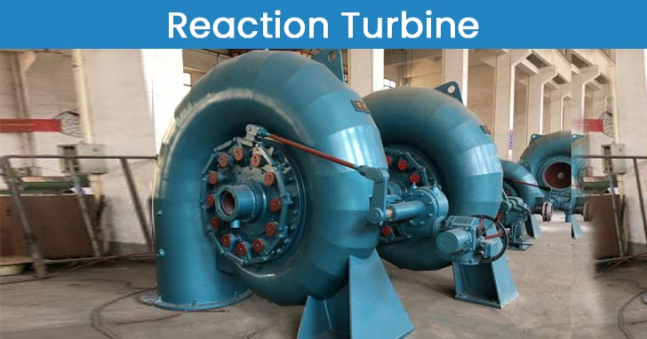

Slide 11
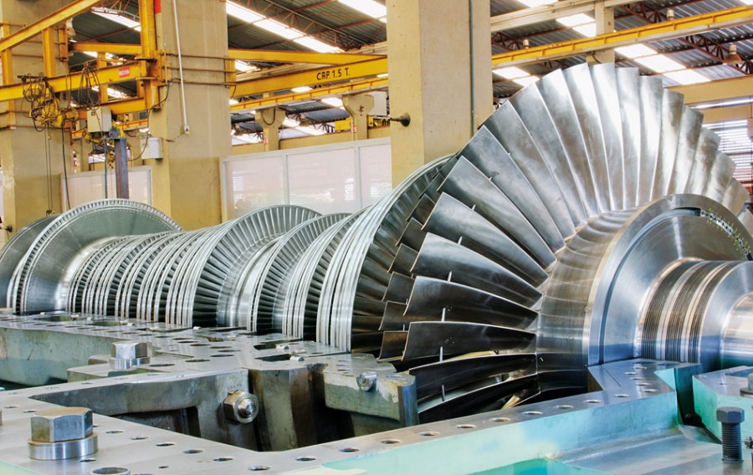

Slide 12
What are Reaction Turbines
Reaction turbines are a type of turbine that develops torque by reacting to the gas or fluid’s pressure or mass. The operation of reaction turbines is described by Newton’s third law of motion (action and reaction are equal and opposite).
In a reaction turbine, the water enters the wheel under pressure and flows over the vanes, As the water, flowing over the vanes, is under pressure, therefore wheel of the turbine runs full and may be submerged below the tailrace or may discharge into the atmosphere.

Slide 13
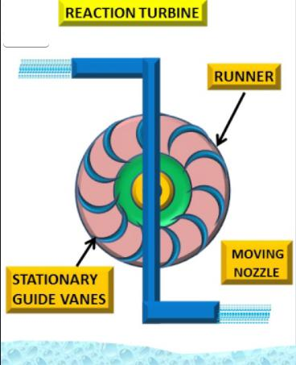
Parts of a Reaction Turbine
Spiral casing: The water, from a pipeline, is distributed around the guides ring in a casing. This casing is designed in such a way that its cross-sectional area goes on reducing uniformly around the circumference. The cross-sectional area is maximum at the entrance and the minimum at the tip. As a result of this, the casing will be of the spiral casing or scroll casing.
Guide mechanism: The guide vanes are fixed between two rings in the form of a wheel. This wheel is fixed in the spiral casing. The guide vanes are properly designed in order to:
To allow the water to enter the runner without shock.
Allow the water to flow over them, without forming eddies.
Allow the required quantity of water to enter the turbine. (this is done by adjusting theopening of the vanes).

Slide 14
3. Turbine runner: The runner of a reaction turbine consists of runner blades fixed either to a shaft or rings, depending upon the type of turbine. The blades are properly designed, in order to allow the water to enter and leave the runner without shock. The runner is keyed to a shaft, which may be vertical or horizontal. If the shaft is vertical, it is called a vertical turbine. Similarly, if the shaft is horizontal, it is called a horizontal turbine
4. Draft tube: The water, after passing through the runner, flows down through a tube called draft tube. it is, generally, drowned approximately 1 m below the tailrace level.

Slide 15
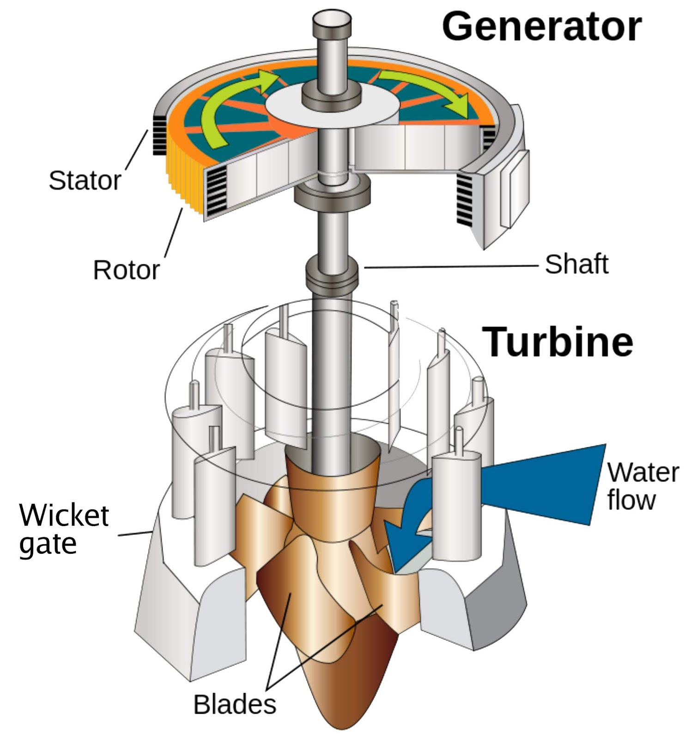
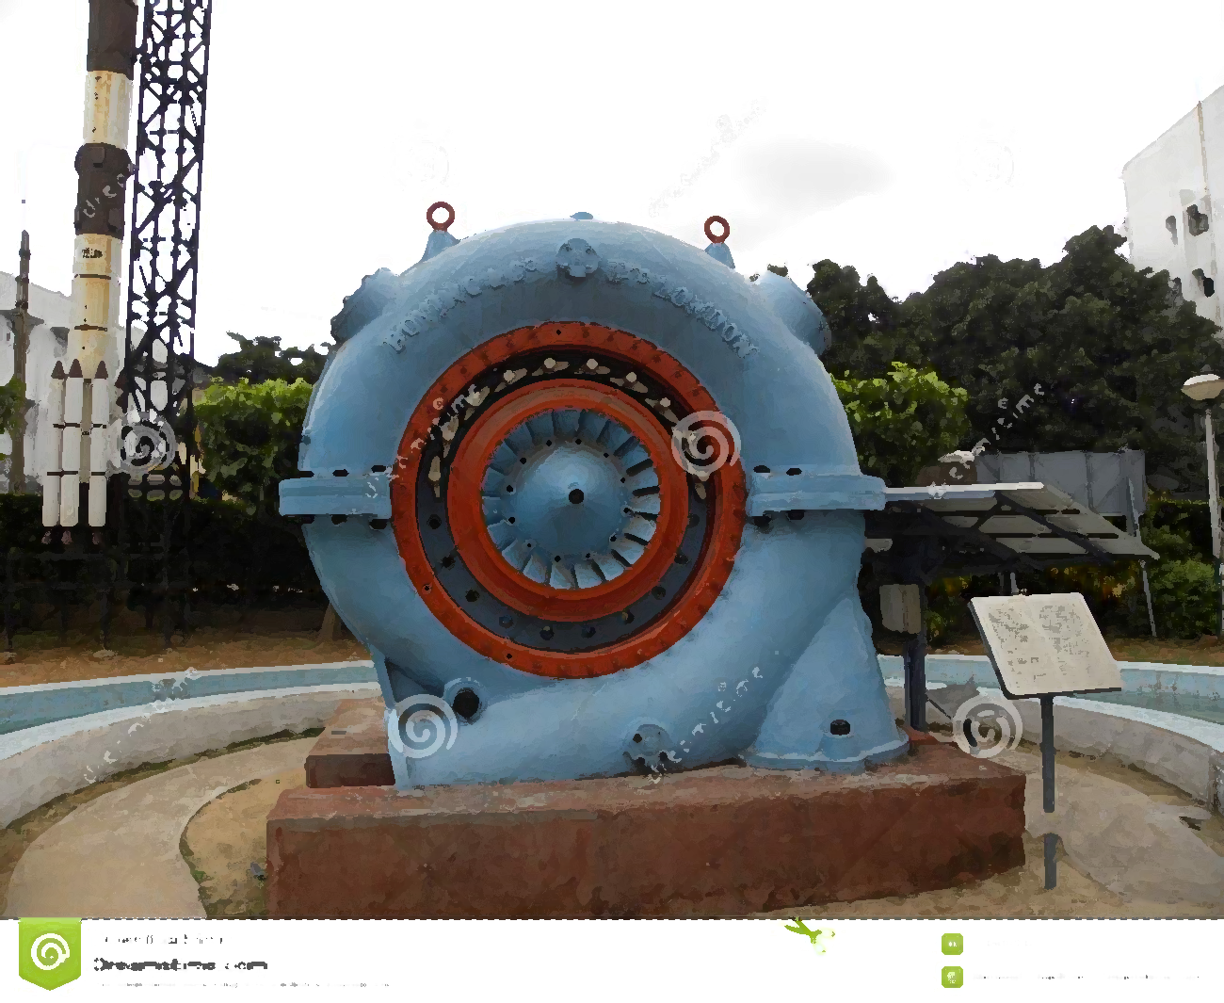
Types of Reaction Turbine
Radial flow turbines: In such turbines, the flow of water is radial (i.e., along with the radius of the wheel). The radial flow turbines may be further sub-division into the following two classes:
Inward Flow Turbine
Outward Flow Turbine

Slide 16
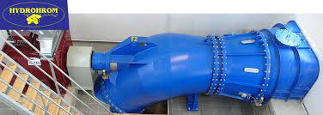
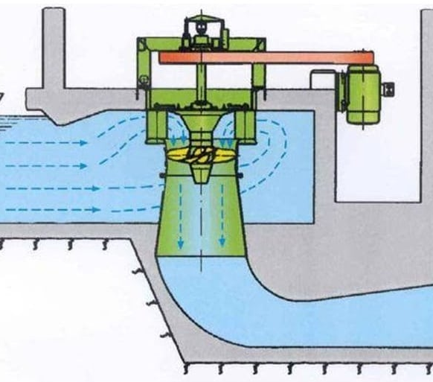
Axial flow Reaction Turbines
In such turbines, the water flows parallel to the axial of the wheel. Such turbines are also called parallel flow turbines. They can be of the Kaplan or Propeller Turbine type.

Slide 17
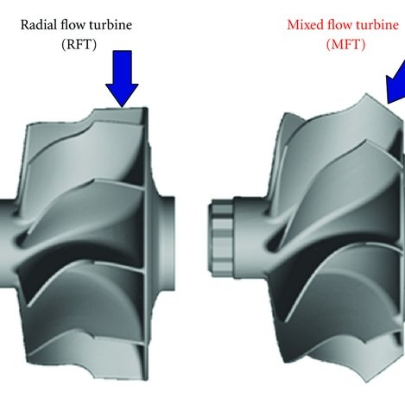
Mixed flow turbines:
The Francis turbine is a type of water turbine that was developed by James B. Francis. It is an inward flow reaction turbine that combines radial and axial flow concepts. They operate in a head range of ten meters to several hundred meters and are primarily used for electrical power production and their output varies from a few kilowatts to 1000 megawatt.

Slide 18
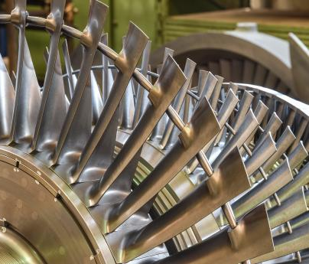
The Differences between a Reaction and an Impulse Turbine

Slide 19
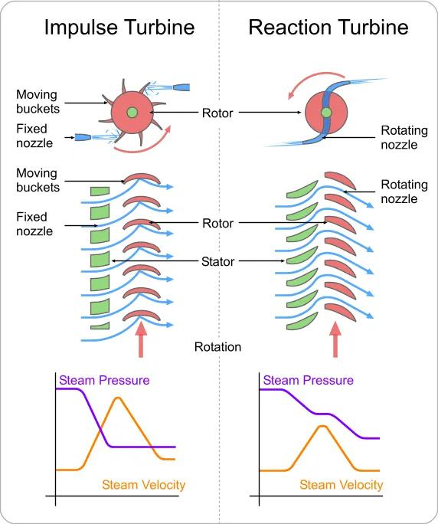

Slide 20
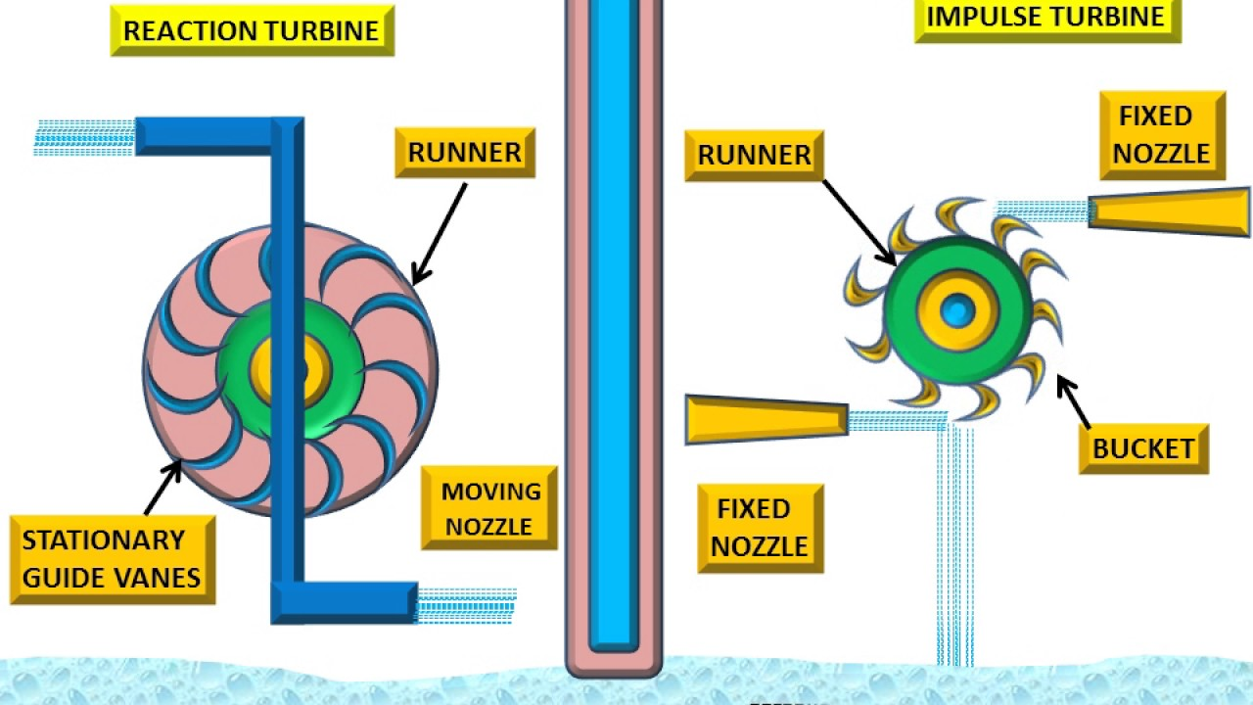

Slide 21
Differences Summarized
In impulse turbine the steam flows through the nozzle and strikes on the moving blades. In reaction turbine steam first flows through the guide mechanism and then flows through the moving blades.
In impulses turbine, steam strikes on the moving blades with kinetic energy only. But in the reaction turbine, the steam which glides over the moving blades possesses both pressure and kinetic energy.
In impulse turbine the pressure of steam remains constant during its flow through the moving blades. But in reaction turbine, the pressure of steam reduces during its flow through the moving blades.
In impulse turbine the steam may or may not be admitted to the whole circumference. In reaction turbine the steam must be admitted to the whole circumference.

Slide 22
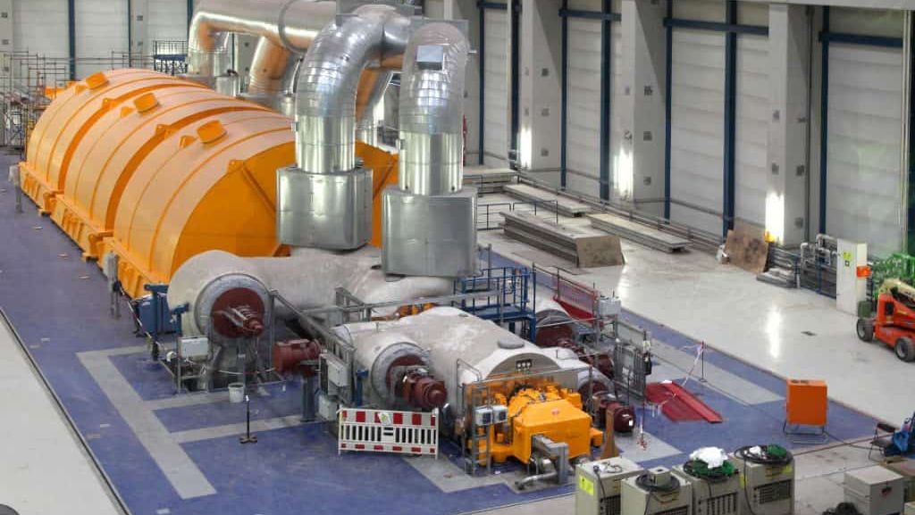
The blades of the impulse turbine are symmetrical where as in reaction turbine it is not symmetrical.
The relative velocity of steam in impulse turbine remains constant but in Reaction turbine it increases while gliding over the blades.
For the same power developed, the number of stages required in impulse turbine is less where as in reaction turbine the number of stages required is more.
The steam flow in impulse turbine is radial to the turbine wheel where as in reaction turbine steam flow is radial and axial to the turbine wheel.
If we talk about the maintenance work, then impulse turbine has less maintenance work as compared with the reaction turbine.
Impulse turbine is suitable where discharge is low and reaction turbine is suitable for medium and high discharge.
Pelton wheel is the example of impulse turbine whereas Francis turbine, Kaplan turbine etc. are the examples of reaction turbine

Slide 23
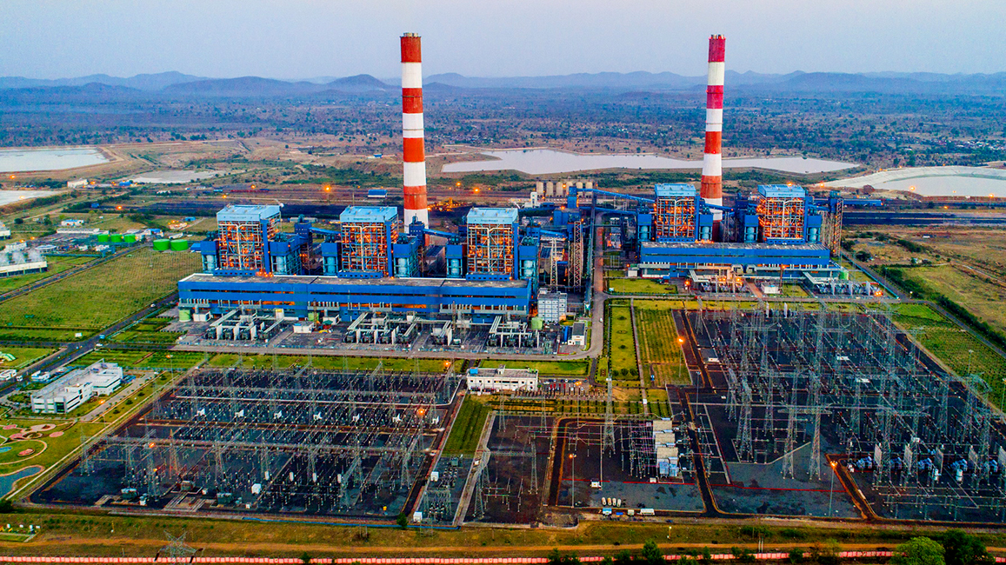
Thank You

